Slide 1
Discrete-time Control Barrier Functions for safe vehicle control
Autonomous and Mobile Robotics - Final project
A.Y. 2020/2021
Candidates
Rossella Bonuomo, 1923211
Marco Pennese, 1749223
Veronica Vulcano, 1760405
Professor Giuseppe Oriolo
Supervisor Tommaso Belvedere

Slide 2
TABLE OF CONTENTS
Introduction
Description and goal of the project
Tools
Model Predictive Control
Control Barrier Functions
Model
Unicycle
Serret-Frenet frames
Implementation
Acados
Car Model and Path
Results
Comments on the tests and on the obtained results

Slide 3
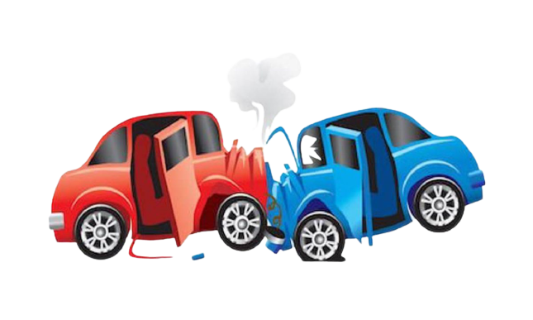
INTRODUCTION
Every engineered system should be designed to be safe, that means that "bad" things are avoided.
Safety-critical optimal control is one of the most important problems in robotics.
The goal of the project is to apply Nonlinear Model Predictive Control with Control Barrier Functions, that generate safety constraints for obstacle avoidance, on the field of autonomous systems.
We are going to study the case of the unicycle by proposing different scenarios, making a comparison between discrete time and continuous time, and finally providing a dynamic extension.

Slide 4
TOOLS: Model Predictive Control
MPC is used to achieve optimal performance while satisfying a set of constraints.
There is an explicit use of a model to predict the process output on a finite prediction horizon by finding a sequence of optimal control actions as a result of an optimization problem.
We are going to consider Nonlinear Model Predictive Control since model and constraints are nonlinear.
Finding the global optimum is more difficult.
Convergence is harder to ensure.
The algorithms are time consuming with respect to the linear case.

Slide 5
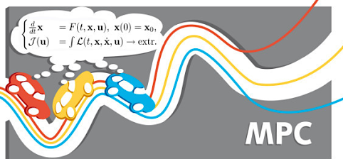
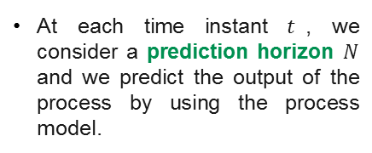
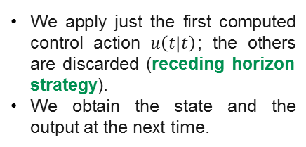
TOOLS: Model Predictive Control
At each time instant $t$, we consider a prediction horizon $N$ and we predict the output of the process by using the process model.
Step 1
The control actions are computed solving an optimization problem which considers a cost function and some constraints.
Step 2
We apply just the first computed control action $u\left(t | t\right)$; the others are discarded (receding horizon strategy).
We obtain the state and the output at the next time.
Step 3
Step 4
The process is repeated.

Slide 6

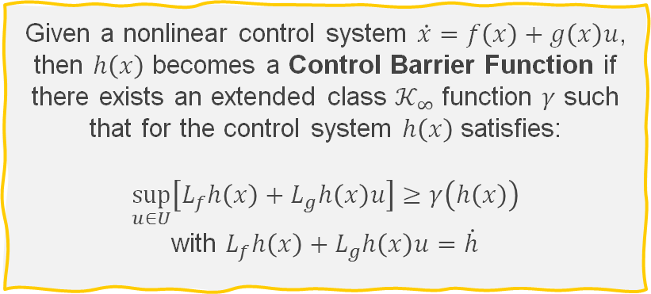
TOOLS: Control Barrier Functions
CBFs allow to express constraints which intrinsically enforce the system to be safe; these constraints can be used in the optimization problem.
In the CBF context, safety is defined in terms of a function ℎ(𝑥), which should be greater or equal than 0.
Given a nonlinear control system $\dot{x}=f\left(x\right)+g\left(x\right)u$, then $h\left(x\right)$ becomes a Control Barrier Function if there exists an extended class $𝒦_{∞}$ function $γ$ such that for the control system $h\left(x\right)$ satisfies:
$$\sup_{u∈U}\left[L_{f}h\left(x\right)+L_{g}h\left(x\right)u\right]≥γ\left(h\left(x\right)\right)$$
with $L_{f}h\left(x\right)+L_{g}h\left(x\right)u=\dot{h}$

Slide 7
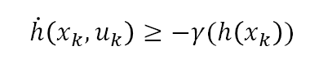
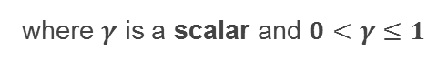
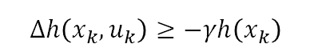
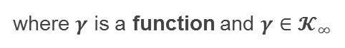
CBF: Continue vs Discrete Time
Continuous Time
Discrete Time
In order the car to be safe we need to satisfy $h\left(x\right)>0$ in each time instant. This results in a well-known constraint in the MPC problem.
In continuous time, the CBF constraint can be expressed as:
In discrete time, the CBF constraint can be expressed as:
$$\dot{h}\left(x_{k}, u_{k}\right)≥−γ(h\left(x_{k}\right))$$
$$Δh\left(x_{k}, u_{k}\right)≥−γh\left(x_{k}\right)$$
where $γ$ is a function and $γ∈𝓚_{∞}$
where $γ$ is a scalar and $0<γ≤1$

Slide 8
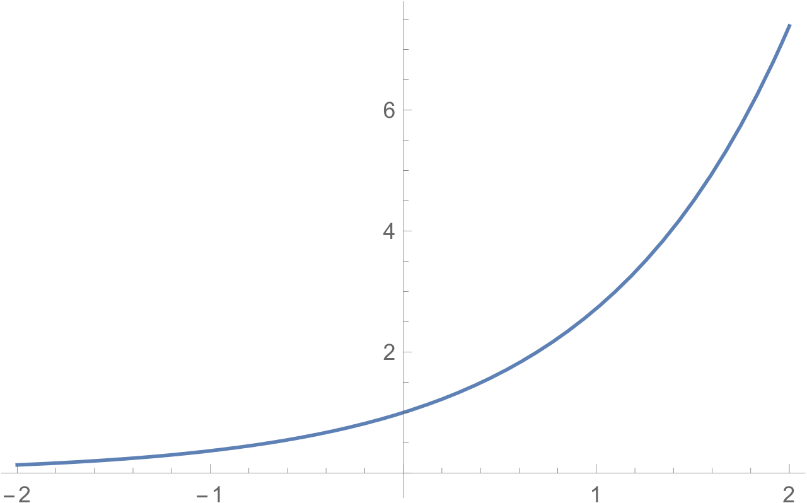
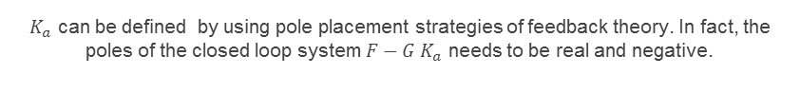
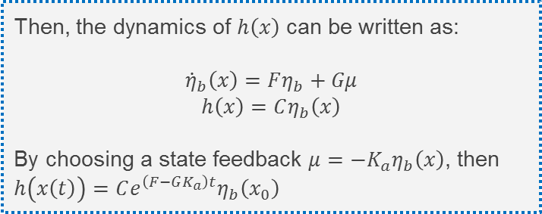
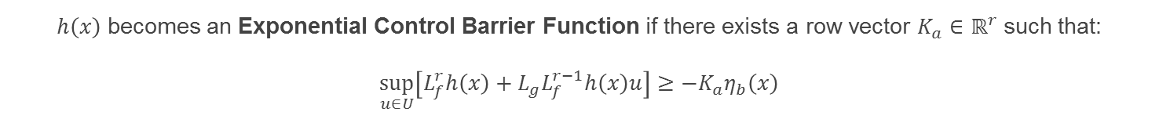
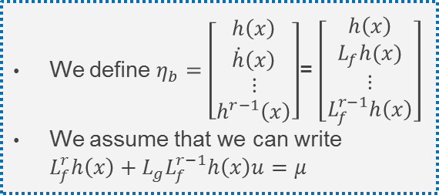
TOOLS: Exponential Control Barrier Functions
ECBFs are needed to deal with high relative-degree safety constraints
We define $η_{b}=\left[\begin{matrix}h\left(x\right) \\ \dot{h}\left(x\right) \\ \begin{aligned}⋮ \\ h^{r−1}\left(x\right)\end{aligned}\end{matrix}\right]$= $\left[\begin{matrix}h\left(x\right) \\ L_{f}h(x) \\ \begin{aligned}⋮ \\ L_{f}^{r−1}h\left(x\right)\end{aligned}\end{matrix}\right]$
We assume that we can write $L_{f}^{r}h\left(x\right)+L_{g}L_{f}^{r−1}h\left(x\right)u=μ$
Then, the dynamics of $h\left(x\right)$ can be written as:
$${\dot{η}}_{b}\left(x\right)=Fη_{b}+Gμ$$
$$h\left(x\right)=Cη_{b}\left(x\right)$$
By choosing a state feedback $μ=−K_{a}η_{b}\left(x\right)$, then $h\left(x\left(t\right)\right)=Ce^{\left(F−GK_{a}\right)t}η_{b}\left(x_{0}\right)$
$h\left(x\right)$ becomes an Exponential Control Barrier Function if there exists a row vector $K_{a}∈ℝ^{r}$ such that:
$$\sup_{u∈U}\left[L_{f}^{r}h\left(x\right)+L_{g}L_{f}^{r−1}h\left(x\right)u\right]≥−K_{a}η_{b}\left(x\right)$$
$K_{a}$ can be defined by using pole placement strategies of feedback theory. In fact, the poles of the closed loop system $F−G K_{a}$ needs to be real and negative.

Slide 9
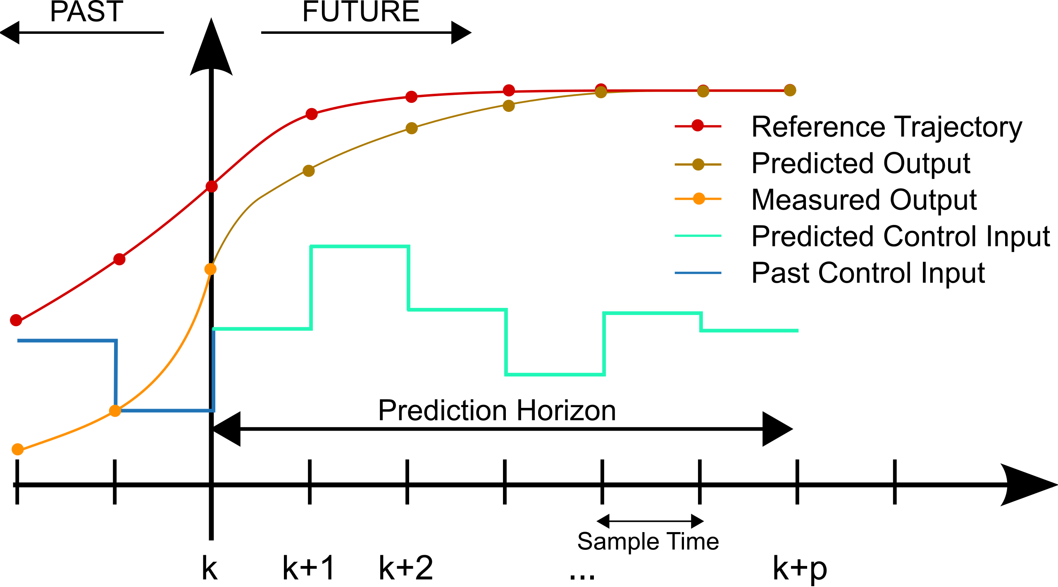
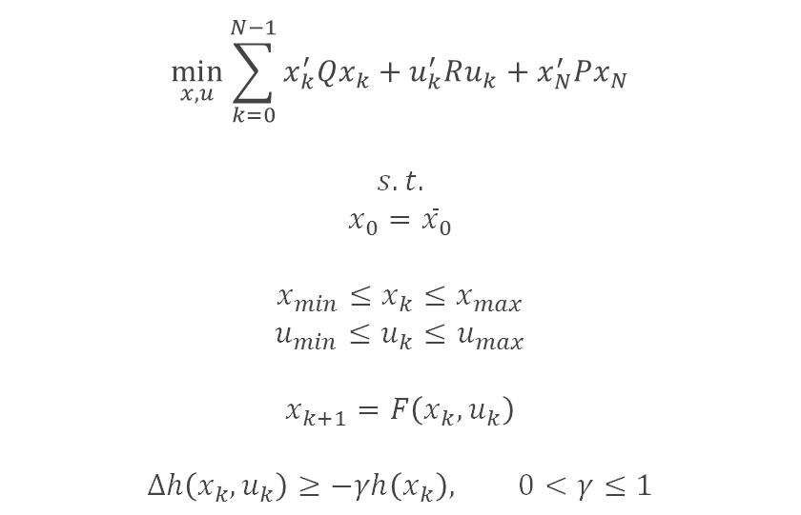
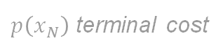
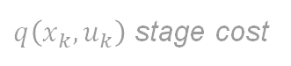
MPC–CBF
Let’s see the formulation of the MPC problem for the discrete-time domain:
$q\left(x_{k},u_{k}\right)$ stage cost
$$\min_{x,u}{\sum_{k=0}^{N−1}{x_{k}^{′}Qx_{k}}+u_{k}^{′}Ru_{k}}+x_{N}^{′}Px_{N}$$
$$s.t.$$
$$x_{0}={\overline{x}}_{0}$$
$$x_{min}≤x_{k}≤x_{max}$$
$$u_{min}≤u_{k}≤u_{max}$$
$$x_{k+1}=F\left(x_{k},u_{k}\right)$$
$$Δh\left(x_{k},u_{k}\right)≥−γh\left(x_{k}\right), 0<γ≤1$$
$p\left(x_{N}\right)$ terminal cost
initial condition
state and input constraints
system’s dynamics
CBF

Slide 10
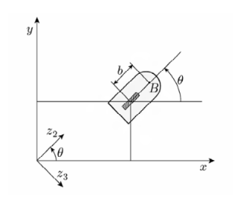
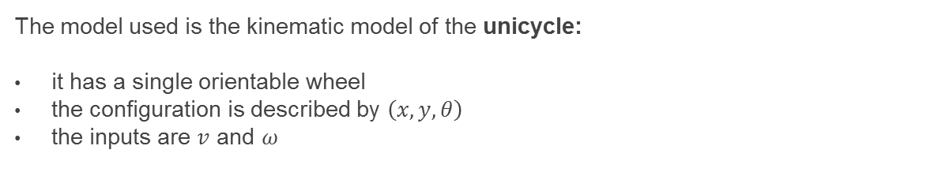
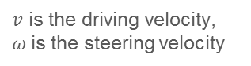
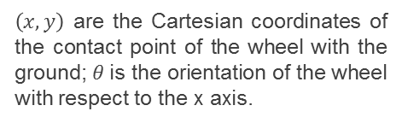
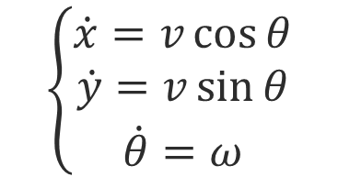
MODEL: Unicycle
The model used is the kinematic model of the unicycle:
it has a single orientable wheel
the configuration is described by $\left(x,y,θ\right)$
the inputs are $v$ and $ω$
$\left(x,y\right)$ are the Cartesian coordinates of the contact point of the wheel with the ground; $θ$is the orientation of the wheel with respect to the x axis.
$v$ is the driving velocity,
$ω$is the steering velocity
$$\left\{\begin{matrix}\dot{x}=v\cos{θ} \\ \dot{y}=v\sin{θ} \\ \dot{θ}=ω\end{matrix}\right.$$
Model expressed in Cartesian coordinates
:

Slide 11
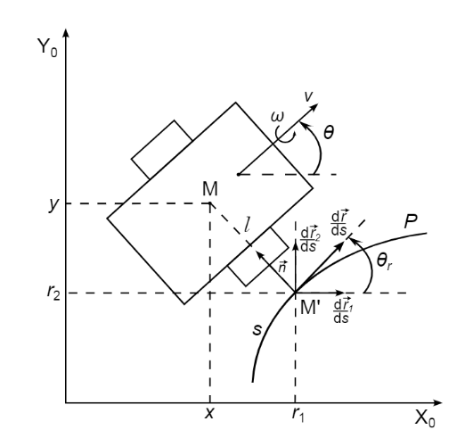
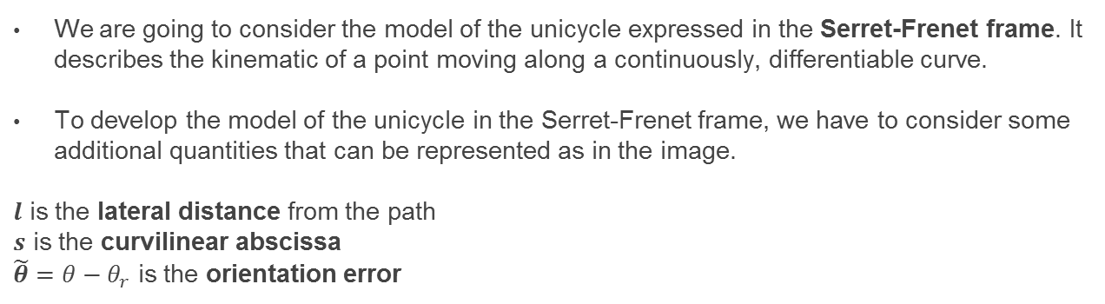
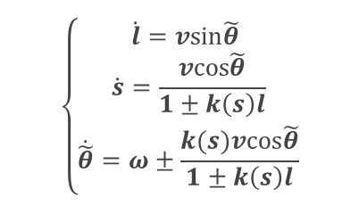
Serret-Frenet Frame
We are going to consider the model of the unicycle expressed in the Serret-Frenet frame. It describes the kinematic of a point moving along a continuously, differentiable curve.
To develop the model of the unicycle in the Serret-Frenet frame, we have to consider some additional quantities that can be represented as in the image.
$l$ is the lateral distance from the path
$s$ is the curvilinear abscissa
$\tilde{θ}=θ−θ_{r}$ is the orientation error
$$\left\{\begin{aligned}\dot{l}=vsin\tilde{θ} \\ \dot{s}=\frac{vcos\tilde{θ}}{1±k\left(s\right)l} \\ \dot{\tilde{θ}}=ω±\frac{k(s)vcos\tilde{θ}}{1±k\left(s\right)l}\end{aligned}\right.$$
Model expressed in Serret-Frenet frame
:

Slide 12


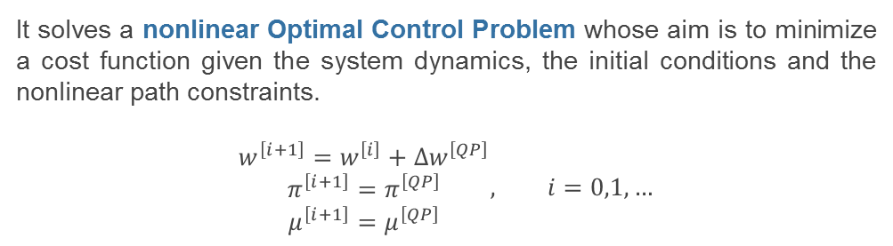
IMPLEMENTATION: acados
Acados is a software package for finding the solution of optimal control and estimation problems.
It provides some libraries written in C which expose very simple interface to Python
It is compatible with the language of CasADi (based on graphs)
It uses BLASFEO for linear algebra operations to speed up the computation
It solves a nonlinear Optimal Control Problem whose aim is to minimize a cost function given the system dynamics, the initial conditions and the nonlinear path constraints.
$$\begin{matrix}w^{\left[i+1\right]}=w^{\left[i\right]}+Δw^{\left[QP\right]} \\ π^{\left[i+1\right]}=π^{\left[QP\right]} \\ μ^{\left[i+1\right]}=μ^{\left[QP\right]}\end{matrix}, i=0,1,…$$
There exist different solution strategies for QP interfaced from acados. We mainly focus on:
qpOASES | HPIPM
Active-set method | Interior-point method

Slide 13

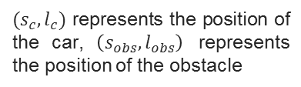
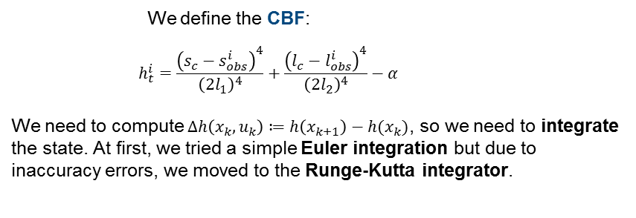
Car Model
The car is represented by a Python class
It takes in input:
the path;
the dimensions of the car;
the fixed obstacle positions;
parameters for the CBF.
Choose the model name;
Define the state and control variables;
Express the dynamic in an implicit and explicit way.
Define the CBF parameters;
We define the CBF:
$$h_{t}^{i}=\frac{{\left(s_{c}−s_{obs}^{i}\right)}^{4}}{{\left(2l_{1}\right)}^{4}}+\frac{{\left(l_{c}−l_{obs}^{i}\right)}^{4}}{{\left(2l_{2}\right)}^{4}}−α$$
We need to compute $Δh\left(x_{k},u_{k}\right)≔h\left(x_{k+1}\right)−h(x_{k})$, so we need to integrate the state. At first, we tried a simple Euler integration but due to inaccuracy errors, we moved to the Runge-Kutta integrator.
$(s_{c},l_{c})$ represents the position of the car, $\left(s_{obs},l_{obs}\right)$ represents the position of the obstacle

Slide 14
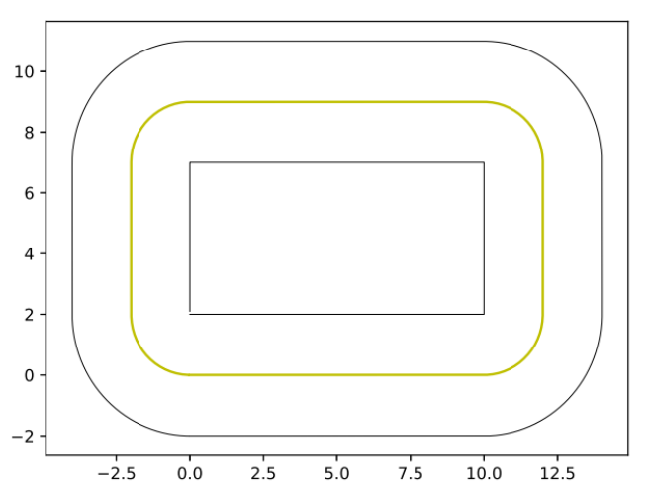
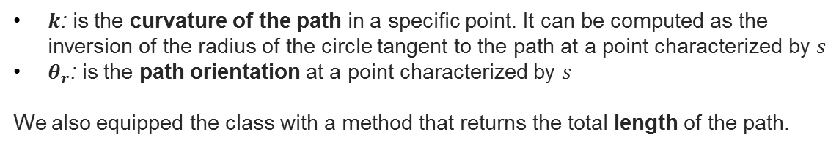
Path
The car has to move along the following path:
It can be created specifying:
the vertical and horizontal length;
the radius of the circumferences.
We let the path provide us some information as a function of the arc length $s$, and these information are useful in the kinematic model:
$k$: is the curvature of the path in a specific point. It can be computed as the inversion of the radius of the circle tangent to the path at a point characterized by $s$
$θ_{r}$: is the path orientation at a point characterized by $s$
We also equipped the class with a method that returns the total length of the path.

Slide 15
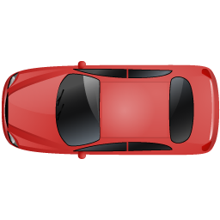
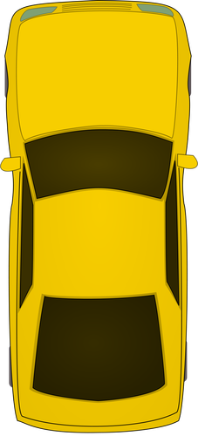

Tests and Results

Slide 16
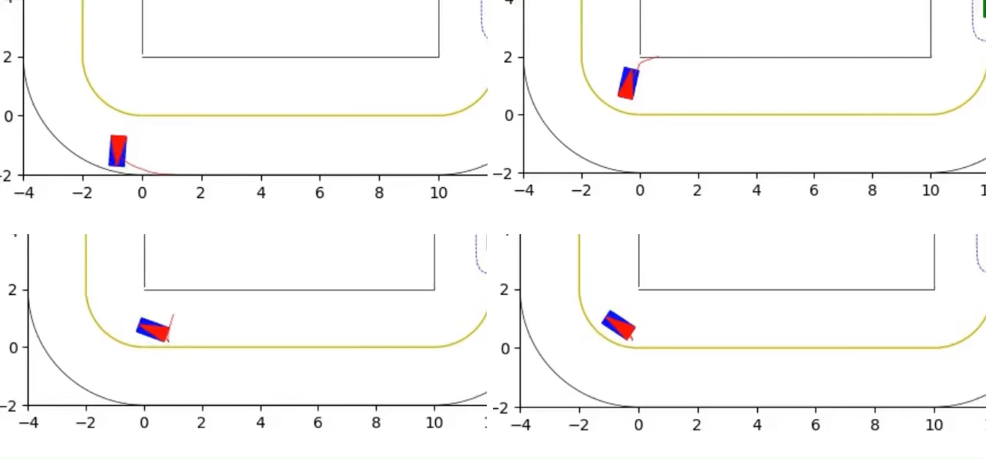

Convergence to trajectory
The aim of these tests is to check that the system is asymptotically stable; we have to be sure that even when the car is far from the reference trajectory, it is able to approach it.
4 tests were performed with 4 different initial configurations.
In all the situations, after some maneuvers, the car is able to approach the path correctly.

Slide 17
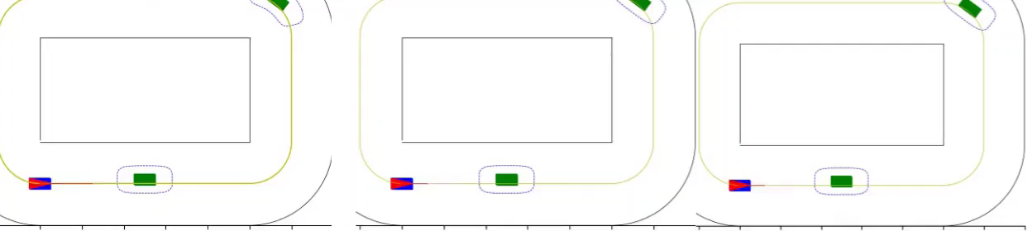
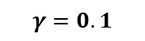
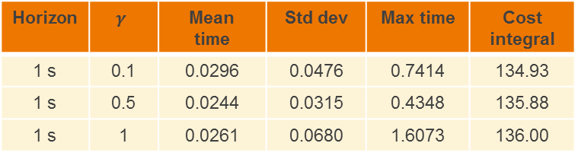
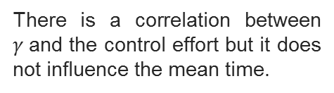

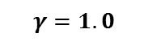
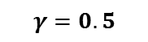
Single car with fixed obstacles
Comparison on $γ →$
it influences the way in which the car overcomes the obstacle. The larger is $γ$, the more the car begins to overtake the obstacle when it is very close to it.
In the last case, the car starts to steer later, so it has to rotate more to overcome the obstacle.
$$γ=0.1$$
$$γ=0.5$$
$$γ=1.0$$
Horizon | $$γ$$ | Mean time | Std dev | Max time | Cost integral
1 s | 0.1 | 0.0296 | 0.0476 | 0.7414 | 134.93
1 s | 0.5 | 0.0244 | 0.0315 | 0.4348 | 135.88
1 s | 1 | 0.0261 | 0.0680 | 1.6073 | 136.00
There is a correlation between $γ$and the control effort but it does not influence the mean time.

Slide 18
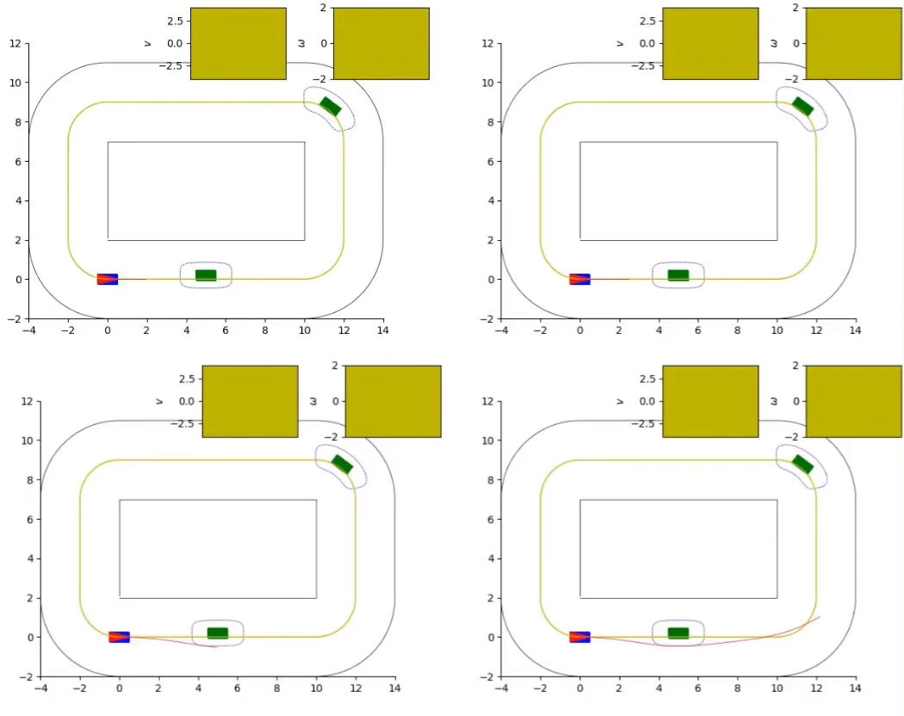
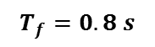

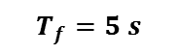
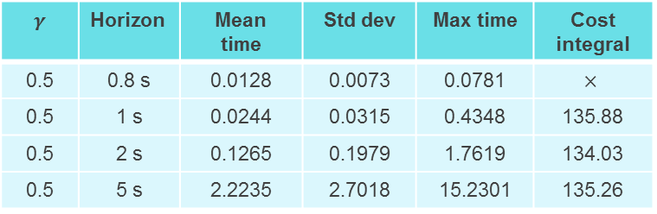
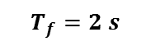
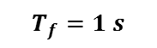
Single car with fixed obstacles (cont.)
Comparison on different prediction horizons
$$→$$
It describes how much we are able to predict in the future.
$$T_{f}=0.8 s$$
$$T_{f}=1 s$$
If the prediction horizon is longer, the car is able to predict a better trajectory.
$γ$ | $$\text{Horizon}$$ | Mean time | Std dev | Max time | Cost integral
0.5 | 0.8 s | 0.0128 | 0.0073 | 0.0781 | $$×$$
0.5 | 1 s | 0.0244 | 0.0315 | 0.4348 | 135.88
0.5 | 2 s | 0.1265 | 0.1979 | 1.7619 | 134.03
0.5 | 5 s | 2.2235 | 2.7018 | 15.2301 | 135.26
By increasing the prediction horizon, the average iteration time increases more than linearly.
$$T_{f}=2 s$$
$$T_{f}=5 s$$

Slide 19
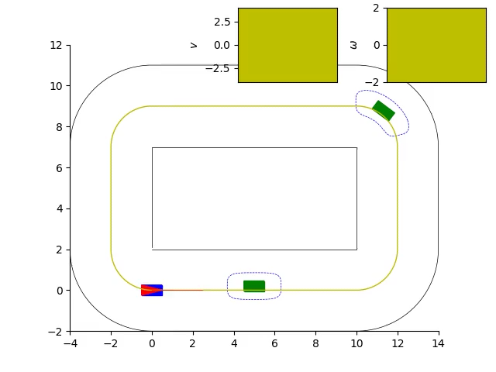
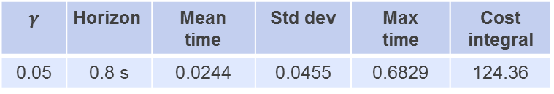
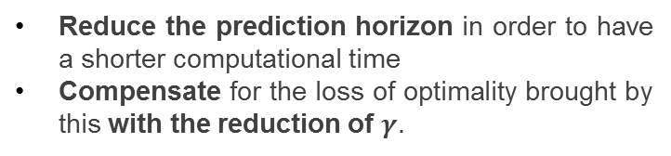
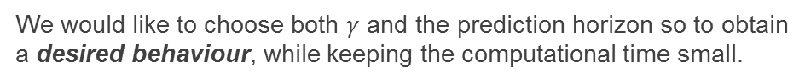
Single car with fixed obstacles (cont.)
We would like to choose both $γ$ and the prediction horizon so to obtain a desired behaviour, while keeping the computational time small.
Reduce the prediction horizon in order to have a shorter computational time
Compensate for the loss of optimality brought by this with the reduction of $γ$.
$γ$ | $$\text{Horizon}$$ | Mean time | Std dev | Max time | Cost integral
0.05 | 0.8 s | 0.0244 | 0.0455 | 0.6829 | 124.36
0.1 | 1 s | 0.0296 | 0.0476 | 0.7414 | 134.93
0.5 | 1.5 s | 0.0636 | 0.0998 | 0.9168 | 134.06
1 | 2 s | 0.1184 | 0.1778 | 1.8536 | 134.05

Slide 20



Single car with moving obstacles
The obstacles move with a constant velocity of $1 m/s$;
The car moves with a target velocity of $2.5 m/s$; therefore, the car will overcome the obstacles.
We consider both discrete time and continuous time by making a comparison on the computational time.
Continuous time
Discrete time
 | $$γ$$ | $$\text{Horizon}$$ | Mean time | Std dev | Max time | Cost integral
Discrete | 0.03 | 1 s | 0.0389 | 0.0554 | 0.7089 | 129.0932
Continuous | $$1.5⋅h(x)$$ | 1 s | 0.0391 | 0.0605 | 0.7497 | 128.9603

Slide 21




Single car with moving obstacles
Comparison of discretization steps in discrete time
The controls for the smaller discretization step look to be piecewise constant.
What about the performance?
N = 10
N = 10
N = 50
N = 50

Slide 22


Multiple cars
In order to make things more challenging, we tried to put together multiple controlled cars moving on the same circuit among obstacles.
We have considered two different approaches:
Centralized approach | Independent approach
All the cars are in the same model. We have a single optimization problem in which each car is aware of the others’ behaviour. | Each car has its own model. We have as many optimization problems as the number of controlled cars.
The number of state variables is $n×m$
$n$ is the number of generalized coordinates
$m$ is the number of cars
The centralized approach is just an ideal behavior; the independent approach is the one that we can find in real applications.

Slide 23


Multiple cars
Differences appear when the cars approach each other.
Let’s see an example of overtaking:
If we look at the final frame, the cars in the centralized approach (on the left) are moved a bit forward with respect to the ones in the independent approach (on the right):
Centralized
approach
Independent
approach

Slide 24



Multiple cars with intersection
Also in this case we consider the independent and centralized approaches
Each car is just aware of other car’s velocity and position but does not know which future actions it will do.
We expect that they are more prudent at the intersection (i.e. they slow down or change the trajectory).
We expect an optimal negotiation when the cars intersect each other.
Independent
Centralized
Independent
Centralized
When the cars are far from each other, they behave in the same way.
When the cars meet, differences appear.

Slide 25




Dynamic extension
The control inputs we are going to consider are the linear acceleration and angular acceleration, so we have to add two integrators in the model:
$$\left\{\begin{aligned}\dot{l}=vsin\tilde{θ} \\ \dot{s}=\frac{vcos\tilde{θ}}{1±k\left(s\right)l} \\ \begin{matrix}\dot{\tilde{θ}}=ω±\frac{k(s)vcos\tilde{θ}}{1±k\left(s\right)l} \\ \dot{v}=a \\ \dot{ω}=a_{ω}\end{matrix}\end{aligned}\right.$$
Continuous time
We have a relative degree $r=2$, therefore we need to design an ECBF. In our case, the ECBF is:
$$\ddot{h}\left(x\right)≥−\left[\begin{matrix}K_{1} & K_{2}\end{matrix}\right]\left[\begin{matrix}h\left(x\right) \\ \dot{h}\left(x\right)\end{matrix}\right]$$
We are going to change the value of $K_{a}=\left[\begin{matrix}K_{1} & K_{2}\end{matrix}\right]$ in order to obtain the desired behaviour.
$K_{a}$ influences the position of the closed loop poles, therefore it will influence the response of the systems at the given inputs.
Discrete time
We don’t need to design an ECBF because the relative degree of the discretized equivalent model is always equal to 1.
In the experiments, we are still going to tune the parameter $γ$ in the CBF in order to obtain the desired behaviour.
Now the state variables are:
$$q=[l, s, \tilde{θ}, v,ω]$$
The output variables are:
$$y=\left[l,s,\tilde{θ}\right]$$
The input variables are
$$u=[a,a_{ω}]$$

Slide 26


Computing derivatives for Continuous CBF
As we have seen, we need to compute derivatives in order to apply the CBF in the continuous case.
Since the relative degree is 2, we need up to the second derivative.
$$h\left(x\right)= \frac{{\left(s_{c}−s_{obs}^{i}\right)}^{4}}{{\left(2l_{1}\right)}^{4}}+\frac{{\left(l_{c}−l_{obs}^{i}\right)}^{4}}{{\left(2l_{2}\right)}^{4}} − α$$
$$\dot{h}\left(x\right)=\frac{4\left({\dot{s}}_{c}−{\dot{s}}_{obs}^{i}\right){\left(s_{c}−s_{obs}^{i}\right)}^{3}}{{\left(2l_{1}\right)}^{4}}+\frac{4\left({\dot{l}}_{c}−{\dot{l}}_{obs}^{i}\right){\left(l_{c}−l_{obs}^{i}\right)}^{3}}{{\left(2l_{2}\right)}^{4}}$$
$$\ddot{h}\left(x\right)=\frac{12{\left( \dot{s_{c}}−{\dot{s}}_{obs}^{i}\right)}^{2}{\left(s_{c}−s_{obs}^{i}\right)}^{2}+4{\ddot{s}}_{c}{\left(s_{c}−s_{obs}^{i}\right)}^{3}}{{\left(2l_{1}\right)}^{4}} +\frac{12{\left( \dot{l_{c}}−{\dot{l}}_{obs}^{i}\right)}^{2}{\left(l_{c}−l_{obs}^{i}\right)}^{2}+4{\ddot{l}}_{c}{\left(l_{c}−l_{obs}^{i}\right)}^{3}}{{\left(2l_{2}\right)}^{4}}$$

Slide 27


Dynamic extension
We run experiments without obstacle to compare the computational time.
Discrete time
Continuous time
 | Mean time | Std dev | Max time | Cost integral
Discrete | 0.0012 | 0.0002 | 0.0034 | 12.7786
Continuous | 0.0012 | 0.0002 | 0.0034 | 12.7786

Slide 28









Dynamic extension – simulations
Continuous time: we are going to change $K_{a}$ so to study the behaviour of the system
Discrete time: we are going to still change $γ$ to study the behaviour of the systems
$K_{a}=[\begin{matrix}225 & 30\end{matrix}]$ the closed loop poles are at -15 along the real axis.
$K_{a}=[\begin{matrix}0.01 & 0.2\end{matrix}]$ the closed loop poles are at -0.1 along the real axis.
$$γ=0.3$$

Slide 29


Dynamic extension – simulations (cont.)
 | Mean time | Std dev | Max time | Cost integral
Discrete time | 0.0029 | 0.0012 | 0.0101 | 15.3281
Continuous time | 0.0025 | 0.0013 | 0.0101 | 15.0242

Slide 30

Conclusions
Control Barrier Function constraints can be used within the Model Predictive Control framework to ensure safety.
CBF constraints allow the system to avoid obstacles even when it is far from them.
It is possible to design a well suited CBF for the specific problem.
As the problem complexity increases, so does the computational time, but we can mitigate this issue by tuning $γ$ and $T_{f}$ accordingly.
Discrete vs Continuous: There is not an evident advantage in performances in using one instead of the other. One could prefer to use the discrete one for its easier formulation.
We have used Real-time iteration (RTI) so to speed up things.
The obtained results are good; in most of the simulations, the car always safely races and overtakes the obstacles, keeping the desired path and the desired target velocity even in the more challenging scenarios.

Slide 31

THANK YOU
FOR LISTENING!

